Slide 2


Slide 3

BOARD GAME

Slide 4
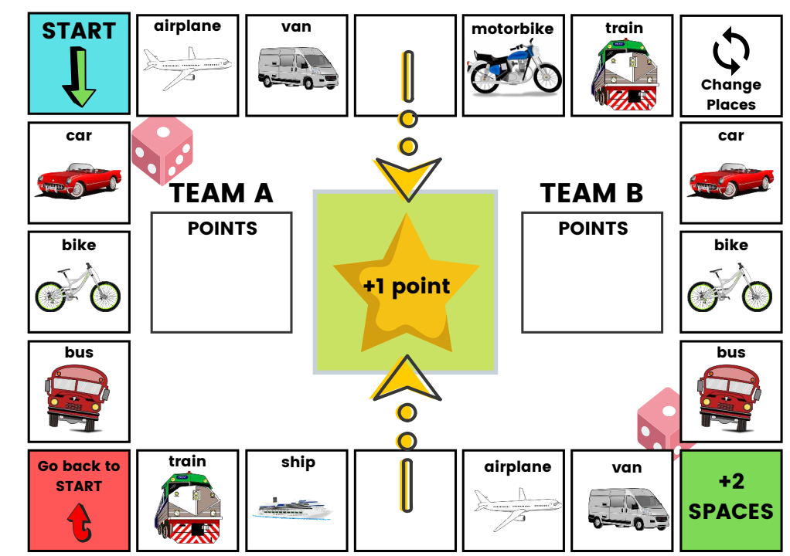

Slide 5
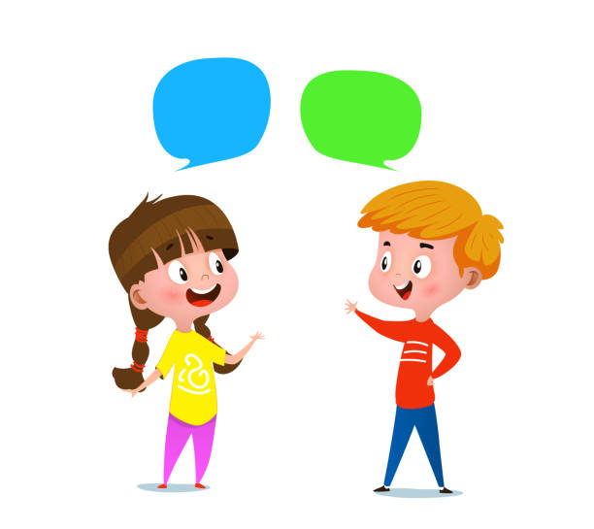
What do you normally do in the summer holidays?
Where do you go? What do you like doing on holiday?
Do you go away with your family?
If you stay at home, do you get bored?

Slide 6
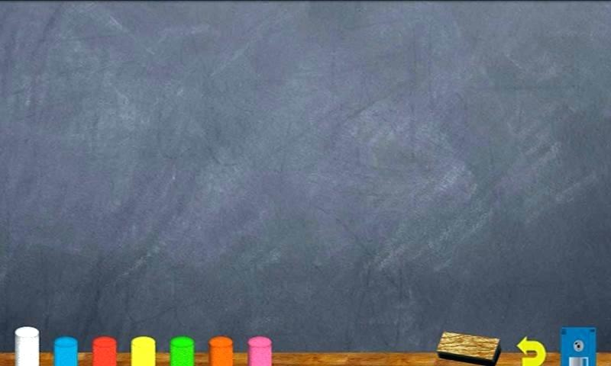
Unit 8:
GOING AWAY
LESSON 2: READING - SUMMER HOLIDAYS

Slide 7
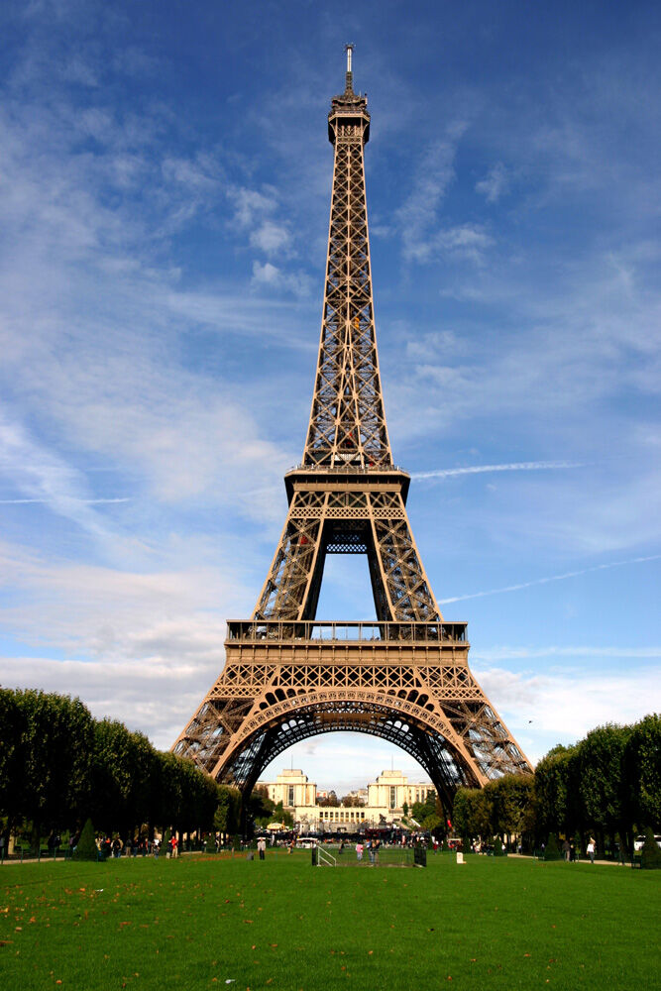
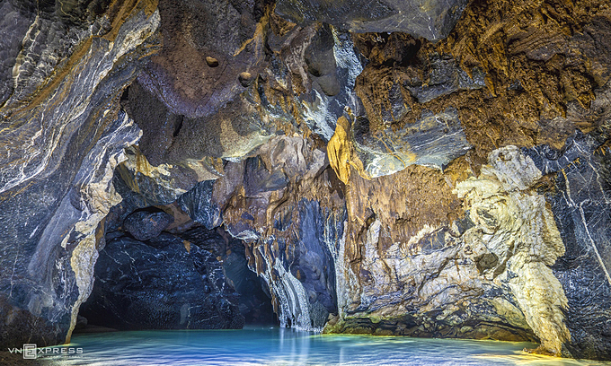
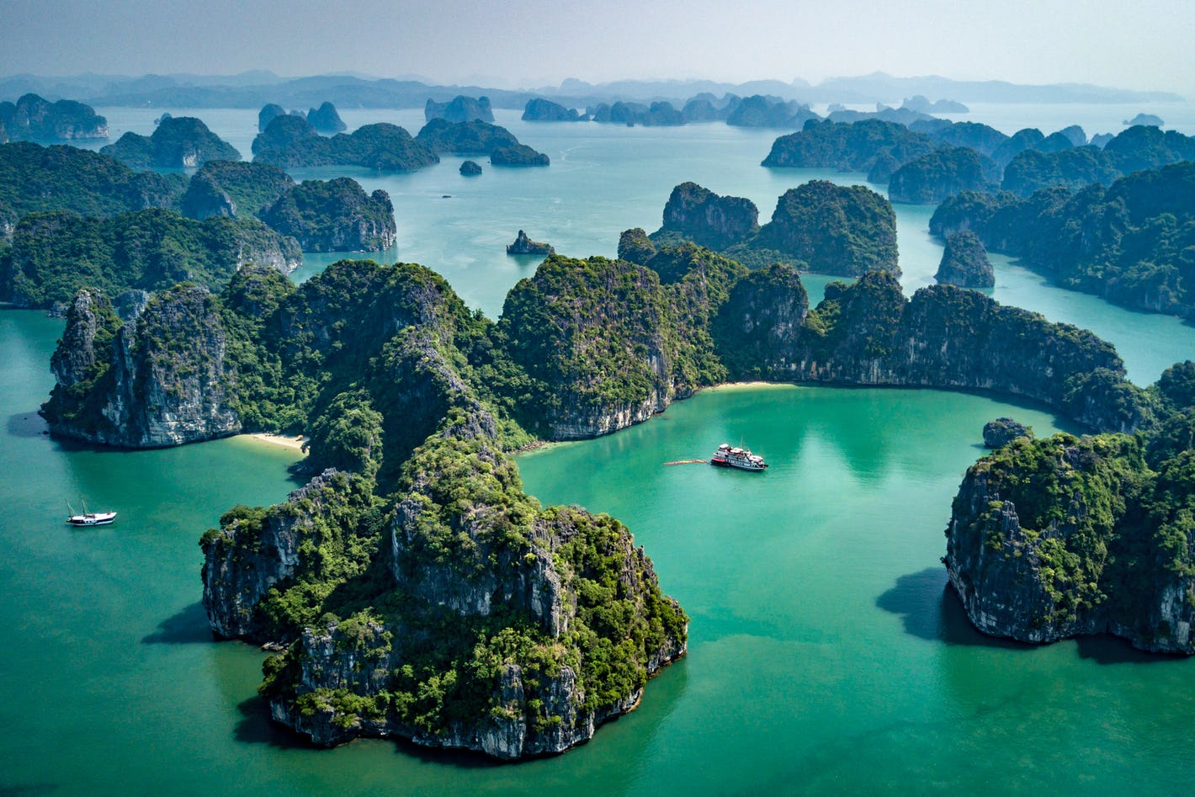
New words
- Eiffel Tower (n) /aɪfəl ˈtaʊə /
- cave (n) /keɪv/
- bay (n) /beɪ/
a large hole in the side of a hill or cliff or under the ground

Slide 8
Read the text and write C (Ciara), M (Martin) or J (Jason)
This person …
1) bought a guidebook last week. _________
2) isn’t going to go away this summer. _________
3) has got Vietnamese friends. _________
4) is going to have a drink with friends. _________
5) is going to explore some caves. _________
6) is going to spend time in an expensive city. _________
C
M
J
M
J
C

Slide 9

TRUE - FALSE QUIZ
1) Ciara is going to
spend a week in Paris.
F
Paris next week.
2)
They are going to learn how to play tennis with a new sports teacher.
F
Martin plans to teach some of his new friends
how to play tennis.
T
3) Jason likes to take amazing photos with his friends.

Slide 10
Optional activity: READING

Slide 11
ANSWER THE QUESTIONS
How does Ciara know that Paris is expensive?
➔ From reading her guidebook.
2) Where is Martin going to learn to play tennis?
➔ At school.
3) Why is Jason going to take some photos with his friends?
➔ Because it is magnificent inside the caves.

Slide 12
VOCABULARY PLUS

Slide 13
Use a dictionary to check the meanings of the adjectives in blue in the text.
: very attractive, fashionable, interesting.
1. cool (adj) /kuːl/
E.g: You look pretty cool with that new haircut.
2. expensive (adj) /ɪkˈspensɪv/
: costing a lot of money.
E.g: Photography is an expensive hobby.
3. boring (adj) /ˈbɔːrɪŋ/
: not interesting in any way.
E.g: This book is boring.
≠ old
4. new (adj) /njuː/
5. magnificent (adj) /mæɡˈnɪfɪsnt/
: very good or beautiful, and very impressive.
E.g: It is magnificent inside the caves
6. awesome (adj) /ˈɔːsəm/
: amazing.
E.g: Their last concert was really awesome.

Slide 14
Optional activity: VOCABULARY

Slide 15
Match the blue adjectives in the text to their opposites 1–6
1) unamazing 2) cheap 3) uncool 4) unimpressive 5) interesting 6) old | cool b) expensive c) boring d) new e) magnificent f) awesome

Slide 16
DISCUSSION

Slide 17
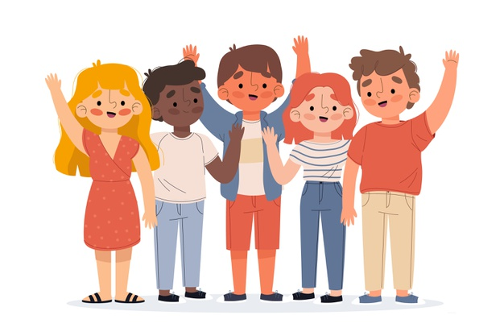
Which holiday do you prefer, Ciara’s, Martin’s or Jason’s? Why?

Slide 18

Learn by heart the new words.
Answer the questions: “Where did you go on your last holiday? What did you do?”
- Prepare the next lesson: LANGUAGE FOCUS.

Slide 19



www.phuongnam.edu.vn

Slide 20



Thank you!
CTCP ĐẦU TƯ VÀ PHÁT TRIỂN GIÁO DỤC PHƯƠNG NAM

